Slide 1

 | S.S.V.P.S’s B. S. Deore Polytechnic, Dhule Department of Computer Engineering Academic Year : 2026-2027
SEMINAR AND PROJECT INITIATION COURSE
Sem : CO 5 K |  | SPI – 315003 | Date : 17/10/2026
Topic : AI-Based Deepfake Video Detection System
Seat No. |  | Name of Student
388573 |  | Shelar Daksh Prashant
388587 |  | Suryawanshi Yuvraj Parikh
388590 |  | Badgujar Tushar Jagdish

Slide 2
Contents
Certificate
Abstract
Introduction
Literature Review
Information to Seminar Topic
Advantages and Disadvantages
Conclusion
Project Initiation :
6.1 Description of problem statement
6.2 Scope and objectives
6.3 Stakeholders
6.4 Seminar execution plan
6.5 Platform / Equipment / Resources identification
Bibliography
References

Slide 3
Abstract
Deep learning methods such as GANs and autoencoders now make it easy to create realistic fake videos, known as deepfakes, which are misused for misinformation, identity fraud, defamation and harassment and weaken trust in video as evidence [12]. This seminar studies an AI-Based Deepfake Video Detection System that analyses a video and decides whether it is real or fake. The system extracts frames, detects and crops faces, learns spatial features with a CNN (XceptionNet / EfficientNet), captures temporal inconsistencies with an LSTM or transformer, and classifies the video with a confidence score [5], [8]. Twelve research works, public datasets (FaceForensics++, Celeb-DF, DFDC) and evaluation metrics are reviewed [1]–[12], and the project initiation details are presented.

Slide 4
1. Introduction
What is a deepfake ?
Why detection is needed
Word formed from “deep learning” + “fake”.
Synthetic media where a person’s likeness is replaced, or made to say and do things they never did.
Mostly made with autoencoders and GANs.
Can influence elections, cause panic, enable fraud or damage reputations.
Humans cannot reliably spot good deepfakes.
Manual checks are slow; AI detection helps journalists, platforms and agencies.
4

Slide 5
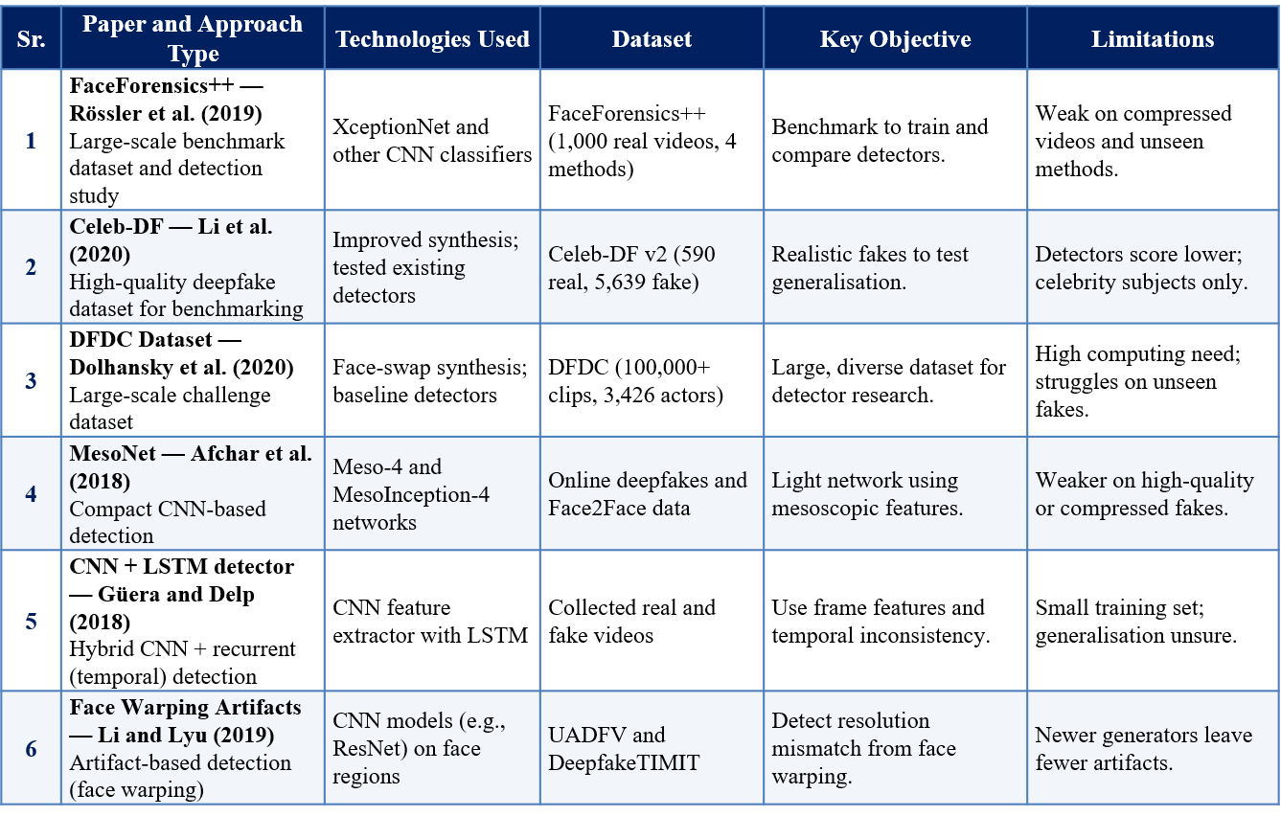
2. Literature Survey

Slide 6
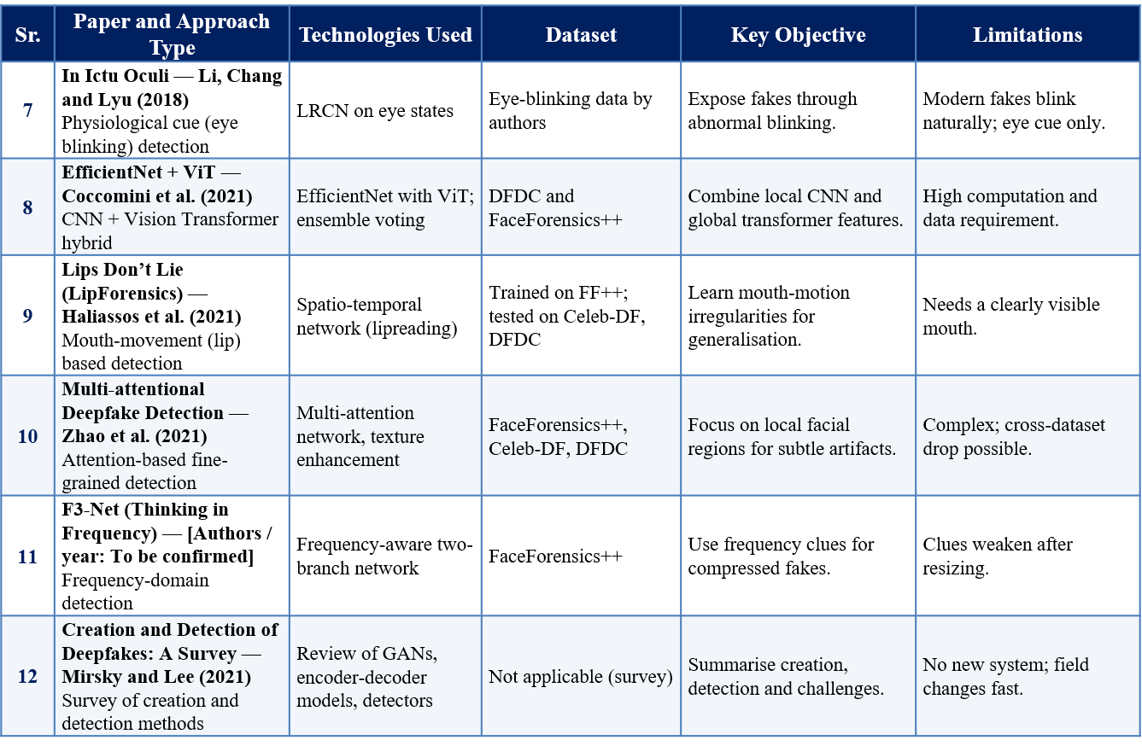

Slide 7
3. Information to seminar topic
Technology : Deep Learning (CNN, LSTM / Transformer) and Computer Vision [12]
Main purpose : To automatically decide whether a video is real or fake [12]
Key concept : Detectors find traces of manipulation such as blending edges, odd blinking and frame flicker [6], [7]
Approach : Frames → MTCNN face crop → CNN features → LSTM / transformer → real / fake score [5], [8]
Main benefit : Fast, scalable verification with a confidence score [1], [3]
Application : Social media, news and fact-checking, law enforcement, banks (video KYC) [3], [12]

Slide 8
4. Advantages / Disadvantages
Advantages
Fast, automatic screening of many videos
Learns subtle artifacts that humans cannot see
Uses both spatial (frame) and temporal (sequence) evidence
Helps journalists, platforms and investigators trust video
Can be retrained as new deepfake methods appear
Disadvantages
Poor generalisation to unseen methods and datasets
Needs large datasets and high computing power
Compression and low quality hide artifacts
False results can harm people or reduce trust
Constant race between generators and detectors

Slide 9
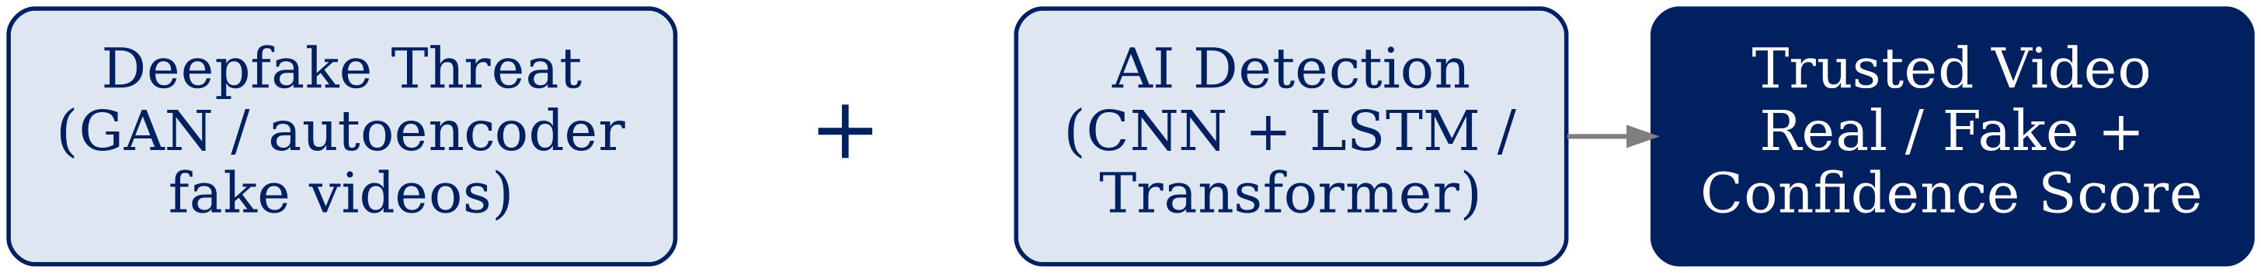
5. Conclusion
Deepfakes made with GANs and autoencoders are now realistic enough to deceive viewers and threaten politics, finance, privacy and public trust [12]. An AI-based detection system gives an automatic, scalable way to verify videos by studying each frame and how frames change over time [5], [8]. Modern detectors perform well on known datasets, but generalisation to new methods and robustness to compression remain open challenges [2], [9]. Detection is therefore a continuously evolving process that needs good datasets, regular retraining and responsible use.
Fig 2: Deepfake threat + AI detection (spatial + temporal) = Trusted video [5], [8], [12]

Slide 10
6. Project Initiation
The AI-Based Deepfake Video Detection project was initiated because anyone can now create convincing fake videos at low cost, and these spread quickly on social media to cause misinformation, fraud and defamation [3], [12]. Human viewers cannot reliably spot good deepfakes and manual forensic checking is too slow [3], [12].
The project aims to build a system that extracts frames, detects faces with MTCNN, learns features with a CNN, analyses temporal behaviour with an LSTM / transformer and classifies the video as real or fake with a confidence score [5], [8].

Slide 11
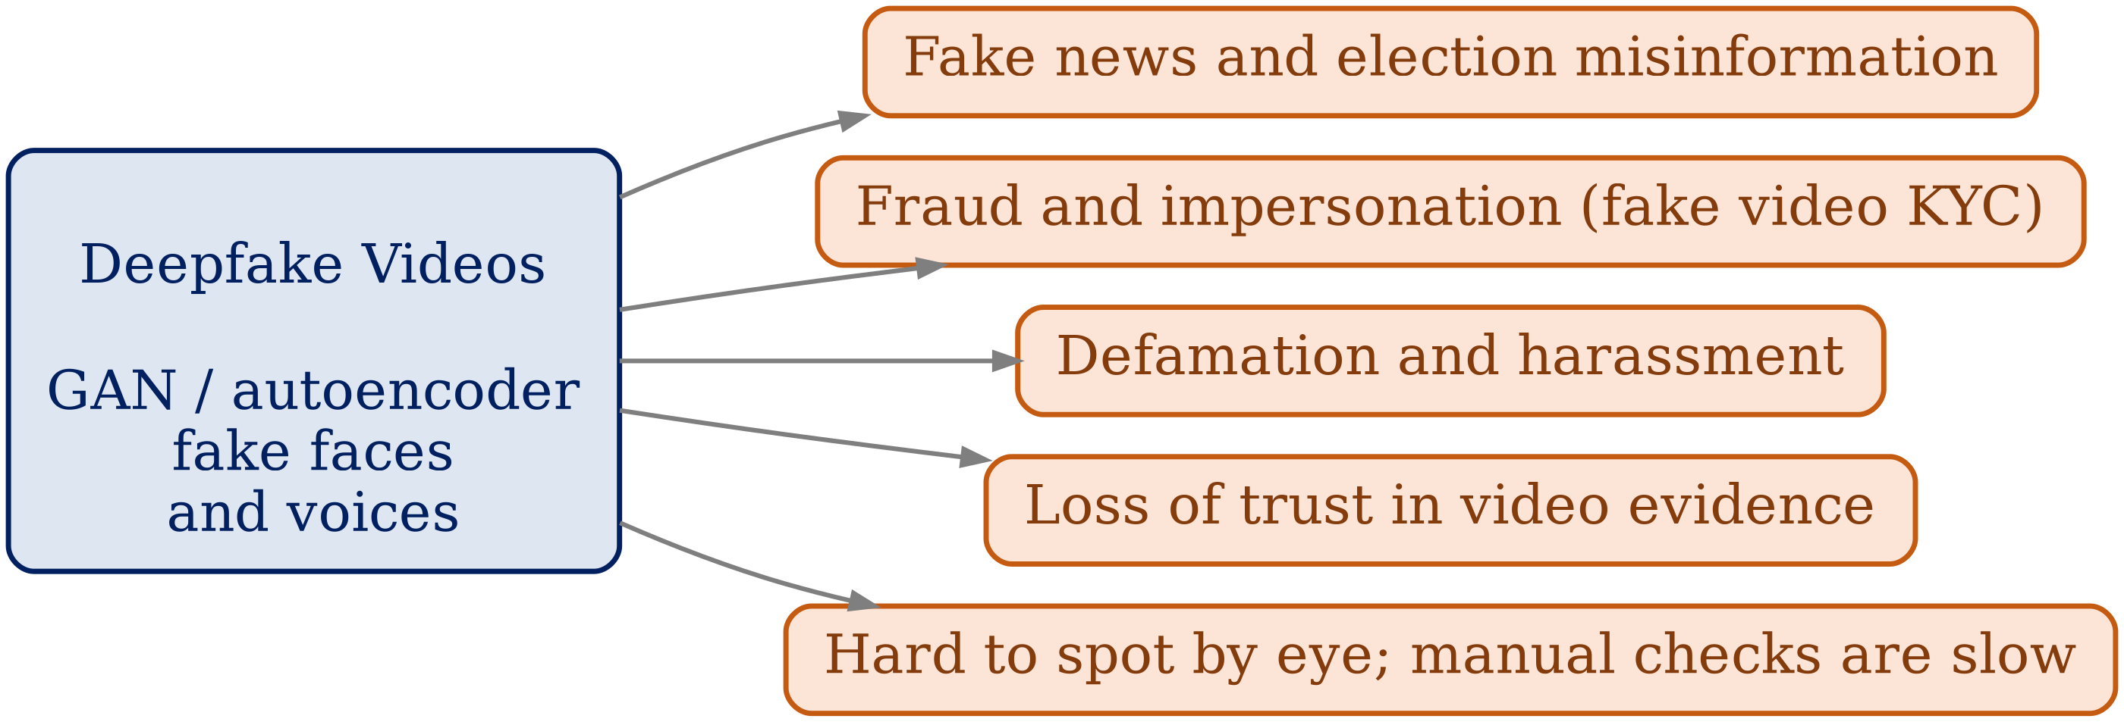
6.1 Description of Problem Statement
Deepfake videos are easy and cheap to create and spread widely on social media before they are noticed [12].
Human viewers and manual forensic checks cannot keep up with high-quality fakes [3].
Existing detectors work well only on trained datasets and fail on compressed or new fakes [2], [9]. A system using spatial and temporal evidence is needed [5], [8].
Fig 3: Problems caused by deepfake videos [3], [12]

Slide 12
6.2 Scope and Objectives
Objectives
Study how deepfakes are created and the artifacts they leave [12].
Review existing research on deepfake video detection [1]–[12].
Build a pipeline for frame extraction, face detection and pre-processing [5].
Classify a video as real or fake using CNN and LSTM / transformer [5], [8].
Evaluate with accuracy, precision, recall, F1-score and AUC [1], [3].
Show the label and confidence score in a simple form to the user.
Scope
Detects face-based deepfake videos; prototype on public datasets [1]–[3].
Uses Python, PyTorch / TensorFlow, OpenCV and MTCNN [5].
Audio-only deepfakes and live-broadcast detection are out of scope.
Helps users, platforms and investigators verify videos [12].

Slide 13
6.3 Stakeholders
End Users / General Public: Upload videos to check real or fake and avoid misinformation [12].
Social Media Platforms / Media Houses: Flag fake videos and verify content before sharing [3].
Law Enforcement / Legal Authorities: Use reports as evidence in fraud and defamation cases [12].
Government / Regulatory Bodies: Policy making, election integrity and national security [12].
Banks / Corporates / Victims: Prevent fraud such as fake video KYC and protect identity [3].
Developers and Project Guide: Build, test and evaluate the system.

Slide 14
6.4 Seminar Execution Plan
Current Scenario: Deepfake videos spread quickly on social media and messaging apps [12].
Deepfake Challenges: Misinformation, fraud, defamation; humans cannot spot good fakes [3], [12].
Existing Approaches: CNN, LSTM, ViT, lip, attention and frequency based detectors [4]–[11].
Research Gap: Detectors work on trained datasets but fail on compressed or unseen fakes [2], [9].
Proposed System: Frame extraction + MTCNN + CNN + LSTM / transformer with confidence score [5], [8].
Future Impact: Reliable video verification and more trust in digital media [12].
Future Work: Real-time detection, audio deepfakes and better generalisation [9], [12].

Slide 15
6.5 Platform / Equipment / Resources
Hardware Requirements:
Computer / laptop (16 GB RAM recommended)
NVIDIA GPU (minimum 6 GB VRAM) for training
SSD / hard disk (minimum 512 GB) for datasets
Webcam / smartphone (optional) and Wi-Fi
Software Requirements:
Operating system: Windows 11 / Ubuntu
Python 3.x with PyTorch / TensorFlow-Keras
OpenCV (frames) and MTCNN (face detection)
NumPy, Pandas, scikit-learn, Matplotlib
VS Code / Jupyter Notebook / Google Colab (free GPU)
Other Resources:
Datasets: FaceForensics++, Celeb-DF, DFDC [1]–[3]
Streamlit / Flask demo interface (optional); internet connection

Slide 16
Bibliography
Research Papers
FaceForensics++ — arxiv.org/abs/1901.08971
Celeb-DF — arxiv.org/abs/1909.12962
DFDC Dataset — arxiv.org/abs/2006.07397
MesoNet — arxiv.org/abs/1809.00888
Websites
PyTorch Documentation — pytorch.org/docs
OpenCV Documentation — docs.opencv.org
Python 3 Documentation — docs.python.org/3

Slide 17
References
Research Papers
[1] Rössler et al. (2019), FaceForensics++: Learning to Detect Manipulated Facial Images
[2] Li et al. (2020), Celeb-DF: A Large-Scale Challenging Dataset for DeepFake Forensics
[3] Dolhansky et al. (2020), The DeepFake Detection Challenge (DFDC) Dataset
[4] Afchar et al. (2018), MesoNet: a Compact Facial Video Forgery Detection Network
[5] Güera & Delp (2018), Deepfake Video Detection Using Recurrent Neural Networks
[6] Li & Lyu (2019), Exposing DeepFake Videos By Detecting Face Warping Artifacts
[7] Li, Chang & Lyu (2018), In Ictu Oculi: Exposing AI Created Fake Videos by Detecting Eye Blinking
[8] Coccomini et al. (2021), Combining EfficientNet and Vision Transformers for Video Deepfake Detection
[9] Haliassos et al. (2021), Lips Don’t Lie: A Generalisable and Robust Approach to Face Forgery Detection
[10] Zhao et al. (2021), Multi-attentional Deepfake Detection
[11] Qian et al. (2020), Thinking in Frequency: Face Forgery Detection by Mining Frequency-Aware Clues
[12] Mirsky & Lee (2021), The Creation and Detection of Deepfakes: A Survey
Other Sources
[13] PyTorch Documentation — pytorch.org/docs
[14] OpenCV Documentation — docs.opencv.org
[15] Python 3 Documentation — docs.python.org/3

Slide 18
Thank you

